Slide 1






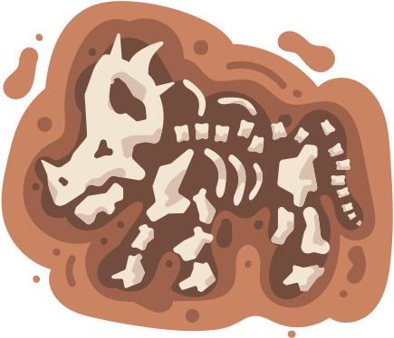
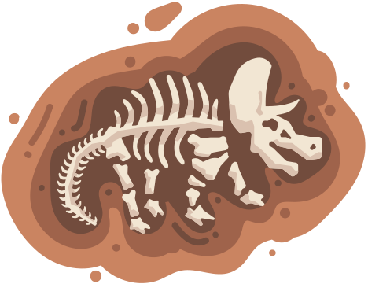
FOSSIL AGE
ESTIMATION

Slide 2

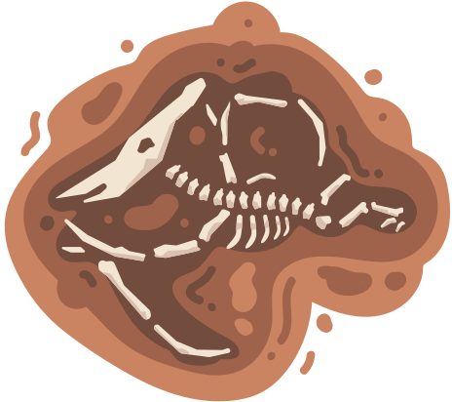








PRESENTERS
Nikhila
Sornapudi
AP21110010923
Rohit Bahadur
Bista
AP21110010941
Shubham
Pandey
AP21110010940
Anu Likitha Immadisetty
AP21110010963

Slide 3

OBJECTIVES
Explain what are fossils and how it became
important to life and environment on
this earth ?
How the machine learning models collaborated with fossil to estimate the age depending on various factors ?
What advancements can future research contribute to our understanding of fossil age?

Slide 4


FOSSILS
What are they and how it became important to life and environment?

Slide 5
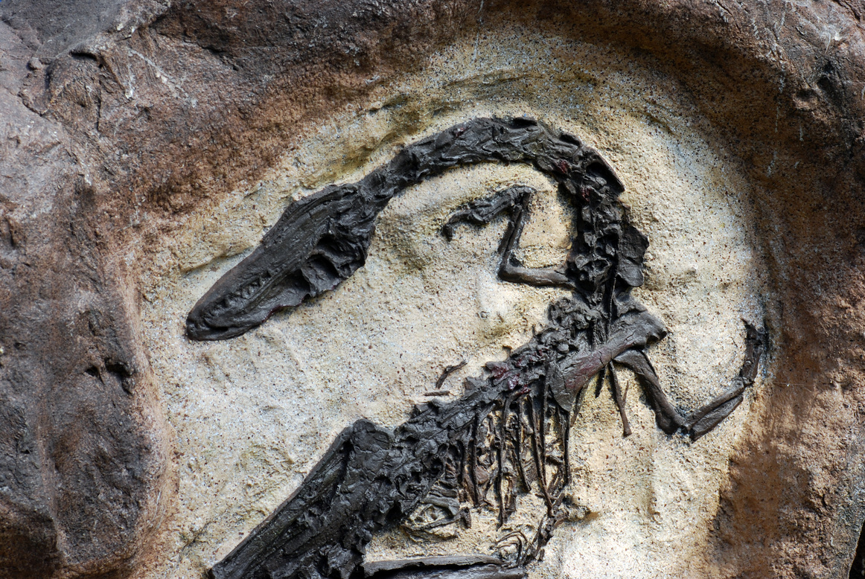
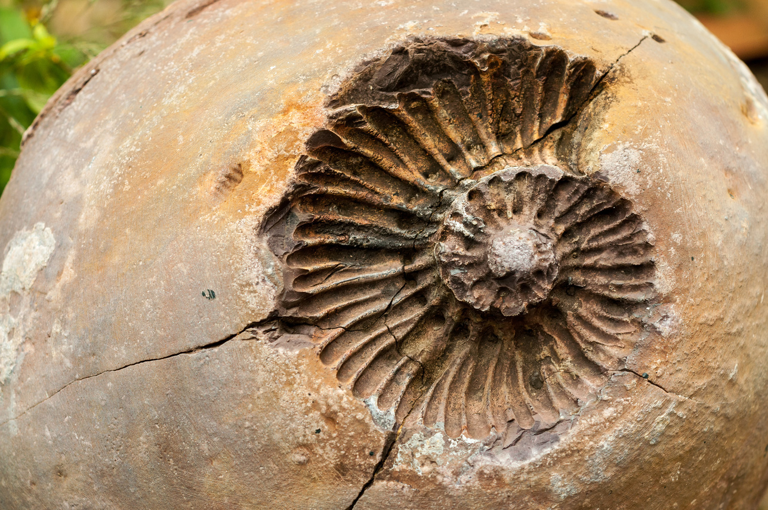
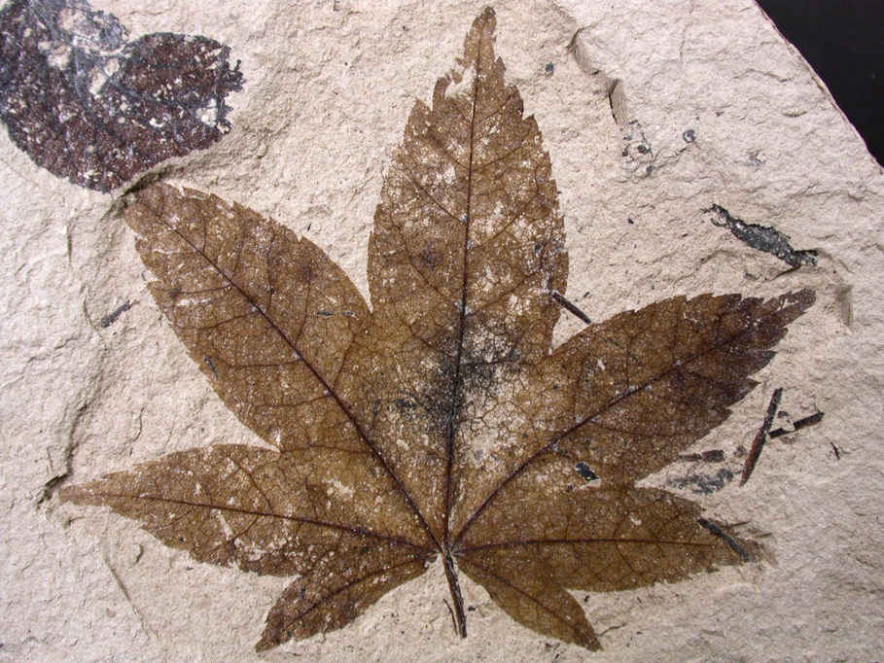
SAMPLE FOSSILS
Fossilized Animal
Fossilized Shell
Fossilized Plant

Slide 6


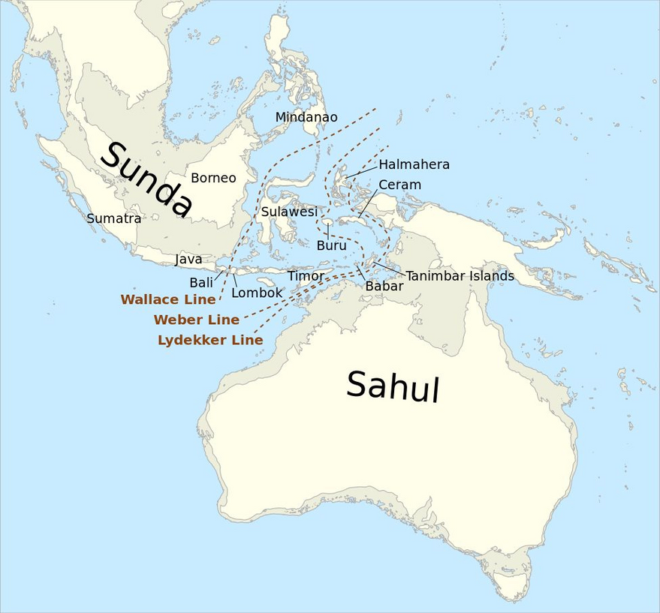
SAHUL DATABASE
SAHUL-LAND encompasses the modern-day landmasses of mainland Australia, Tasmania, New Guinea and the Aru Islands

Slide 7

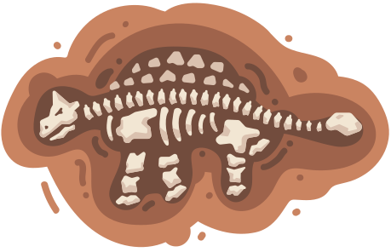

Explain how did you manage the missing values in the dataset?
1
DATA PREPROCESSING
Explain how did you transform categorical data to numerical format?
2
3
How did you do scaling to numerical data?

Slide 8


INTEGRATION OF MACHINE LEARNING MODELS WITH FOSSILS

Slide 9

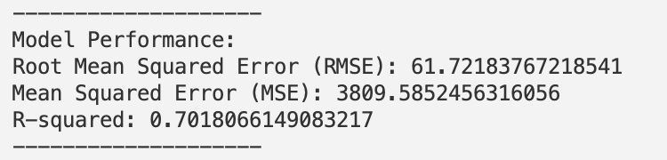

LINEAR REGRESSION

Slide 10
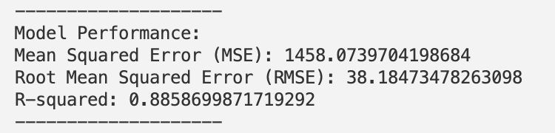
RANDOM FOREST

Slide 11
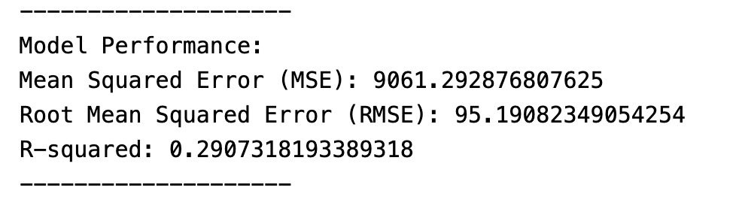
SUPPORT VECTOR REGRESSION (SVR)

Slide 12
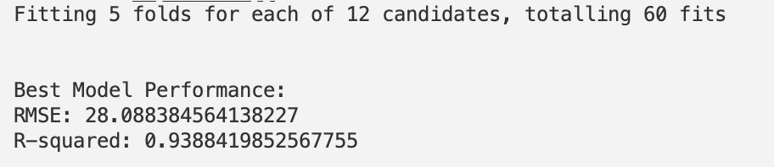
SUPPORT VECTOR REGRESSION (SVR)
WITH GRIDSEARCHCV

Slide 13
RESULTS
Comparision of Machine Learning Models Performance
LINEAR REGRESSION
RANDOM FOREST
SUPPORT VECTOR REGRESSION (SVR)
WITH GRIDSEARCHCV

Slide 14



THANK YOU!

